Slide 1
BLOCKCHAIN

Slide 2
Introduction about blockchain
A blockchain is a digital transaction of records that’s arranged in chunks of data called blocks.
These blocks link with one another through a cryptographic validation known as a hashing function.
Linked together, these blocks form an unbroken chain—a blockchain.
A blockchain is programmed to record not only financial transactions but virtually everything of value.
Another name for blockchain is distributed ledger.

Slide 3
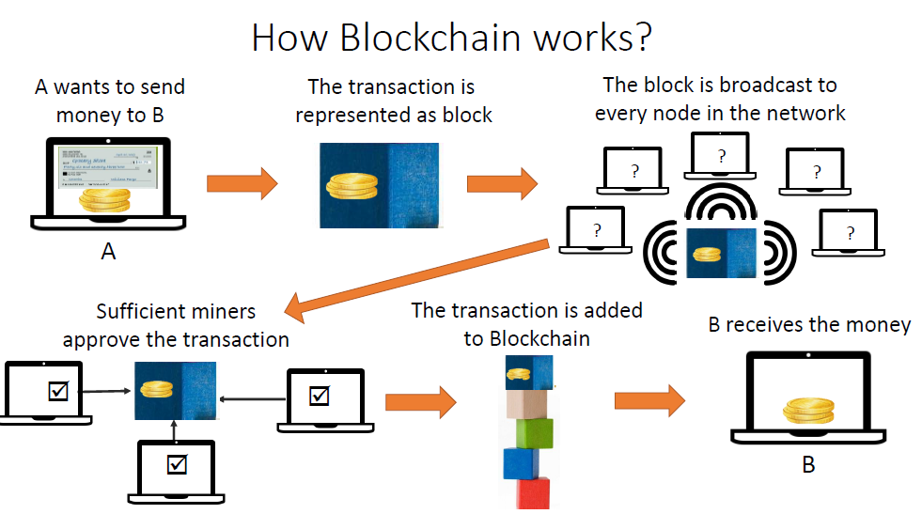

Slide 4
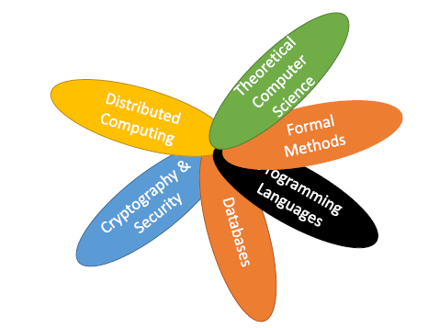
Blockchain is interdisciplinary

Slide 5
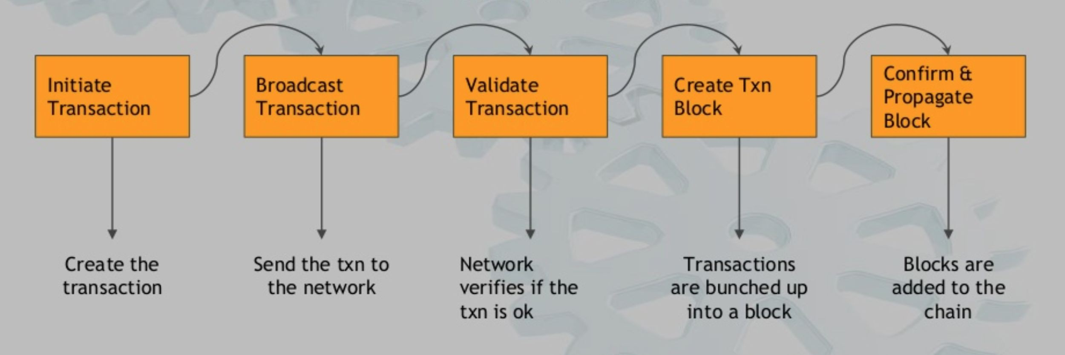
HOW DOES BLOCKCHAIN WORK

Slide 6
A blockchain is, in the simplest of terms,
a time-stamped series of immutable records of data
that is managed by a cluster of computers
not owned by any single entity.
Each of these blocks of data (i.e. block) is secured and bound to each other using cryptographic principles (i.e. chain).

Slide 7
The blockchain network has no central authority —
it is the very definition of a democratized system.
Since it is a shared and immutable ledger, the information in it is open for anyone and everyone to see.
Hence, anything that is built on the blockchain is by its very nature transparent
everyone involved is accountable for their actions.

Slide 8
Blockchain is a shared, immutable ledger that facilitates the process of recording transactions and tracking assets in a business network. An asset can be tangible (a house, car, cash, land) or intangible (intellectual property, patents, copyrights, branding).
Virtually anything of value can be tracked and traded on a blockchain network, reducing risk and cutting costs for all involved.

Slide 9
Why blockchain
#. Bring Trust : To establish trust between ourselves, we depend on individual third parties such as banks, land registries, government etc.
#. Decentralization: Chances of error, mistakes and corruption can happen in centralized control systems.
#. Remove Middle Man : They always comes with somewhat risk and cost.

Slide 10
Some terms
The word “cryptocurrency” is derived from the encryption techniques which are used to secure the network.
Blockchains, which are organizational methods for ensuring the integrity of transactional data, is an essential component of many cryptocurrencies.
A cryptocurrency is a new form of digital asset based on a network that is distributed across a large number of computers.
This decentralized structure allows them to exist outside the control of governments and central authorities.

Slide 11
BLOCKCHAIN
Blockchain is a completely new distributed infrastructure and computing paradigm formed by reorganizing mature technologies such as
hash function,
Merkle tree,
Proof of work (PoW)
combining cryptographic technologies such as public key encryption, digital signature and
.

Slide 12
Blockchain technology is characterized by anti-counterfeiting, non-tampering
and easy to implement smart contracts, and is known as a new technology that will lead to social change

Slide 13
In order to realize trusted transactions in distributed environment, blockchain technology uses
cryptographic technology to hide user information, while all transaction information is verified and stored by distributed network.

Slide 14

The history of Bitcoin
2008
Idea was published under the pseudonym Satoshi Nakamoto
2009
Start of the Bitcoin NetworkZ
2010
Fist cryptocurrency stock exchange is launched
2011
One Bitcoin equals one USD
2013
1 Bitcoin equals
100 USDV
2014
Microsoft accepts Bitcoin
2017
1 Bitcoin equals
10,000 USD

Slide 15
Classification- According to different application scenarios and network admission mechanism
Blockchain technology can be divided into
public chain,
alliance chain
private chain.

Slide 16
PUBLIC CHAIN
In the public blockchain,
data can be easily accessed,
which provides an unprecedented opportunity for data analysts t0 analyze various behaviors in the system by using transaction data
The public chain is usually also called Permissionless Blockchain.
Anyone can participate in the maintenance and accessing to the data on the blockchain,
easy to deploy applications, and completely decentralized without being controlled by any institution.

Slide 17
PUBLIC CHAIN
Bitcoin, Ethereum etc., have no restrictions on the joining and exiting of nodes, are typical public chains.
At present, various public chains such as Bitcoin, Ethereum etc., have obtained a large number of users and accumulated a large amount of transaction data.
The public chain is a fully decentralized blockchain.
It uses cryptography to ensure that transactions cannot be tampered with.

Slide 18
Alliance chain
is a kind of blockchain that requires registration permission.
This kind of blockchain is also called Permissioned Blockchain.
The alliance chain is limited to the participation of alliance members, and the scale of the alliance can be as large as between countries, or between different institutions and enterprises.
The number of nodes is much smaller compared to public blockchain, such as bitcoin blockchain, since the nodes can join the network only when they are trusted.

Slide 19
PRIVATE CHAIN
Private chains, which are limited to enterprises, state agencies or individuals, cannot completely solve the trust problem, but can improve auditability.
It is often used for internal database management, auditing, government budget and execution, or government industry statistics, etc.
They need to be transparent to each other, but not to the public.

Slide 20
Public Blockchain : No access restriction every participant would able to read
and write.
● Private Blockchain : It is permissioned based in which network administrators
(owner) invite to selected member, It is read by all but only owner has the right
to making any changes in rules or other terms.
● Consortium /Alliance Blockchain : It is semi-decentralized system in which number of
organization controlling to it. Control of write, read and verify provided to
group of organization.

Slide 21
The value of the private chain is mainly to provide a secure, traceable, non-tamperable, automatic execution computing platform, which can prevent both internal and external security attacks on data, which is difficult to achieve in traditional systems.

Slide 22
BLOCKCHAIN ARCHITECTURE
Blockchain is the underlying technology of Bitcoin.
In 2008, a scholar named “Satoshi Nakamoto” proposed a digital currency called Bitcoin.
In the absence of any authoritative intermediaries, people who do not trust can pay directly in Bitcoin.
In October 2016, China Blockchain Technology and Application Development White Paper published by the Ministry of Industry and Information Technology described Blockchain Technology as a new application mode of computer technology, such as distributed data storage, point-to-point transmission, and consensus mechanism and encryption algorithm.

Slide 23
Bitcoin ≠ blockchain
Is the underlying datastructure, which can be used for many things, including cryptocurrencies
Is an application of blockchain technology

Slide 24
Technical architecture of the blockchain
. Proposed a five-layer framework:-----PROPOSED BY MEMBERS YANG
data layer,
network layer,
consensus layer,
incentive layer,
contract layer and
application layer.

Slide 25
Another proposal from the perspective of privacy protection: three-tier framework
network layer,
transaction layer and
application layer.
From the perspective of facilitating data analysis, this paper proposed a three-tier framework:
application layer,
contract layer,
transaction layer.

Slide 26
3 tier architecture

Slide 27
Layers in blockchain
The three-tier framework not only represents three types of block chain data, but also represents three stages of block chain development.
Bottom layer---transaction layer,
Block chain development stage --- Block chain development stage 1.0,
i.e programmable currency, represented by Bitcoin.
Transaction means not only ---to change blockchain data, Transaction is an important basic data in blockchain.
Major task of blockchain 1.0--- Recording transactions to ensure the global uniqueness and irreversible modification of blockchain data.

Slide 28
The middle layer is the contract layer,
Block chain development stage --- Block chain development stage .2.0,
i.e programmable finance, Ethereum is representative.
Smart contract was proposed by Szabo in 1994, a digital protocol that uses algorithms and procedures to compile contract terms, deploys on blockchain, and can be automatically executed according to rules.
The smart contract itself is also an important data type for Blockchain 2.0, which we call contract data.
The deployment and operation of smart contracts is not only inseparable from transactions, but also generates new transaction data.

Slide 29
The top layer is the application layer,
Block chain development stage --- Block chain development stage .3.0,
i.e programmable society, such as decentralized application, decentralized autonomous organization.
The application layer can be built on top of the contract layer to implement many complex automation functions, or directly on the transaction layer (thus the contract layer is represented by dotted lines).
At present, because the blockchain technology is still in the early stage of development, there is a lack of application data combined with actual scenarios.

Slide 30
The operating environment of the blockchain is distributed, and its three-tier framework is in a distributed environment.
For example, the same smart contract is stored as a type of data on every node in a distributed environment.
When a transaction triggering contract operation is received, each node runs the relevant contract based on the local blockchain data and stores the running results in the local data.
Finally, through the consensus mechanism, the local data is consistent with the entire
distributed network.
In a distributed network environment of blockchain, there are usually a large number of nodes.

Slide 31
3. Blockchain data structure and data type
In order to achieve data tampering, the blockchain is constructed into a chain structure in units of blocks.
The data structures on different blockchain platforms are slightly different, but basically the same.
Each block is identifiable by a hash, generated using the SHA 256 cryptographic hash algorithm on the header of the block.
Each block references a previous block, also known as the parent block, in the “previous block hash” field, in the block header

Slide 32
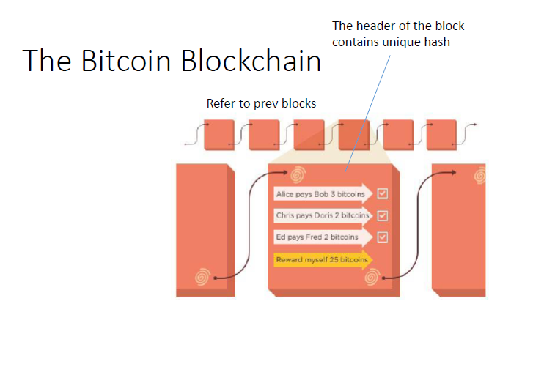

Slide 33
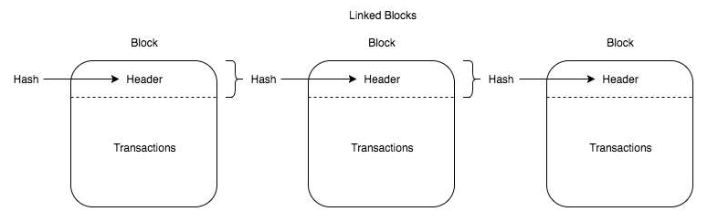

Slide 34
3.1 Blockchain data structure
Taking Bitcoin as an example, each block is composed of a
block header
block header stores a pre-block hash (PrevBlockHase) , random number (Nonce), Merkle root (MerkleRoot), PoW etc
block body,
and block body stores multiple transactions that occurred after the previous block;.
The blockchain guarantees irreversible modification of data based on two hash structures, Merkle tree and block list.

Slide 35
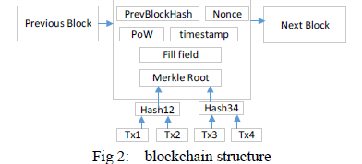

Slide 36
The Merkle tree
First proposed by Ralph Merkle and was originally used to generate summaries of digital certificate directories.
Bitcoin uses the simplest binary Merkle tree.
The list of transactions is stored as a Merkle tree. A Merkle tree is a tree data structure in which every leaf node is the hash of a transaction and every non-leaf node is the cryptographic hash of the child nodes
Each node in the tree is a hash value, and stores a SHA256 hash value of a transaction data.
The values of two leaf nodes are spliced/joined together, and then the values of the parent node are obtained by hashing operation.
Repeatedly calculate the hash value of the parent node until the root is generated, that is, transaction merkle root.
With the Merkle root, tampering of any transaction data in the block is detected, ensuring the integrity of the transaction data.

Slide 37
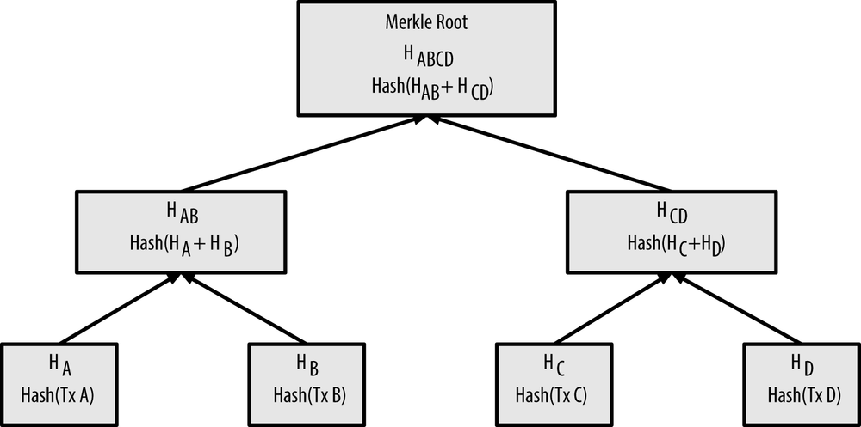

Slide 38
Without the involvement of other nodes in the tree, we can confirm whether a transaction occurs based on the SPV (Simplified Payment Verification) only according to the direct branch from the transaction node to the Merkle root path.
Eeg- only the nodes Hash34, Hash12, and Merkle roots in Figure 2 can be used to verify that the transaction Tx4 is located in the block.
In a block consisting of N transactions, at most 2log2 (N) hash operations can be performed to verify the existence of the transaction.
Without the need for full data participation, customers can verify the existence of a transaction, making it ideal for building light clients or e-wallets.

Slide 39
In Ethereum, the Merkle root is calculated using the Merkle Patricia tree because the transaction data in the block does not change much, but the status data often changes and the number is large.
When building a new block, the Merkle Patricia tree only needs to calculate the account status that has changed in the new block, and branches with no change in status can be directly referenced without recalculation

Slide 40
Block list
The hash value of the block header is obtained by performing a SHA256 hash operation on the metadata such as the Prev-BlockHash, the Nonce, and the Merkle root in the block header.
PrevBlockHash stores hash value of the previous block.
All blocks are linked together in the order of generation with PrevBlockHash as a hash pointer, forming a block list.

Slide 41
The block header contains the transaction Merkle root, so you can verify whether the block header and transaction data have been tampered with by Hash operation.
The block header also contains the previous block hash value PrevBlockHash, so it is also possible to verify whether all blocks from the previous block of the block to the creation block have been tampered with by block hashing.
Relying on the PrevBlockHash, all blocks are interlocked, and any block is tampered with, causing a chain change of all the block hash pointers.
When a block and all previous blocks are downloaded from an untrusted node, block hashing can be used to verify whether each block has been modified.

Slide 42
3.2 Data model
Transaction model
Account-based model

Slide 43
3.2 data type
Transaction data model.
A transaction in the blockchain is usually a transfer, and Figure shows the data structure of the transaction in Bitcoin.
Each transaction includes multiple transaction inputs and multiple transaction outputs, indicating that one transaction can merge the bitcoins in the previous plurality of accounts and transfer them to another plurality of accounts.

Slide 44
TRANSACTION INPUT
Each transaction input is mainly composed OF
the hash value of the last transaction (PrevTxHash),
the output index (Index) and
the input script (ScriptSig).
The input of a transaction
corresponds to the output of the previous transaction,
PrevTxHash saves the hash of the previous transaction output
Index
indicates that this transaction input corresponds to which transaction output in the transaction history.
The script (ScriptSig)
contains the signature of the Bitcoin holder on the current transaction

Slide 45
TRANSACTION OUTPUT
Each transaction output
includes the transfer amount (Value)
script script-PubKey containing the recipient's public key hash (script-PubKey).

Slide 46
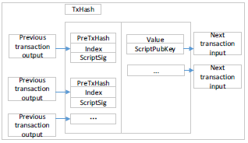
Data structure for bitcoin transaction

Slide 47
In the transaction-based model, all transactions depend on the hash pointer of the previous transaction to form a list of transactions as nodes.
Each transaction can be traced back to the first transaction in the trading chain Coinbase (ie bitcoin from mining).
Transaction-based model can effectively prevent counterfeiting, double-flower attacks against digital currency.

Slide 48
(2) Account-based model.
The transaction-based model makes it easy to verify transactions, but it cannot quickly query user balances.
To support more types of industry applications, blockchain platforms such as Ethereum and Hyperledger Fabric use an account-based model to easily query the transaction balances or trading status data.
Smart contracts are also better suited to build on an account-based model that is easier to handle complex business logic for state data.
The accounts under Ethereum are divided into two types:
External account (Externally Owned Account) and
Contract account (Contract Account).
The external account is used to record the Ethereum balance,
the contract account is used to store the smart contract.

Slide 49
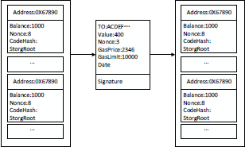
When a transaction occurs, it will trigger a change in account status.[figure]
External accounts and contract accounts are represented by the same data structure in Ethereum, which contains four attributes:
Balance,
Nonce,
CodeHash and
StorageRoot.

Slide 50
Balance records the Ethereum balance of the account.
Nonce counts the number of transactions initiated by the account to prevent replay attacks.
CodeHash is the hash value of the contract code when the account is applied to a smart contract.
StorageRoot is the MerklePatricia root of contract status data

Slide 51
Ethereum's transactions include seven attributes:
To - saves the recipient's account address
Value -Value is the amount of ethernic currency transferred.
Nonce-Nonce counts the number of transactions initiated by the transaction
gasPrice- GasPrice is the unit price of the Ether of Gas at the time of the transaction
gasLimit- gasLimit is the maximum amount of Gas allowed to execute this transaction
Data - Data is the message data when the smart contract is invoked
transaction signature.-is the initiator's ECDSA signature of the transaction.
Elliptic Curve Digital Signature Algorithm (ECDSA) offers a variant of the Digital Signature Algorithm (DSA) which uses elliptic curve cryptography.
On the ethereum blockchain, gas refers to the cost necessary to perform a transaction on the network.
Miners set the price of gas and can decline to process a transaction if it does not meet their price threshold.

Slide 53
Contract data
Introduced in the year 1995,
cryptographer Szabo first proposed the concept of smart contract.
He pointed out that "smart contracts stimulate contract execution by using protocols and user interfaces".

Slide 54
Smart contract is
a commercial contract; self-executing contracts containing the terms and conditions of an agreement among peers.
The terms and conditions of the agreement are written into code.
written in a programming language that automatically enforces the terms of the contract when the predetermined conditions are met,
Thus ,achieving the goal of "code is the law."

Slide 55
The existing smart contract works like the If-Then statement of other computer programs.
The smart contract executes on the Ethereum blockchain's decentralized platform.
The agreements facilitate the exchange of money, shares, property, or any asset.
Because blockchain data has important features such as non-tampering and complete credibility, building smart contracts based on blockchain data has natural advantages.
There are two widely-used programming languages for writing Ethereum smart contracts – Solidity and Serpent

Slide 56
The life cycle of smart contract includes three stages:
contract generation,
contract publication and
contract execution.

Slide 57
Contract generation mainly includes four aspects:
multi-party negotiation,
contract specification,
contract verification, and
contract code.
The specific implementation process is as follows:
The contract participants negotiate with each other;
the parties clarify their respective rights and obligations,
jointly determine the contract text,
write the program, test the program, and finally obtain the standard contract code.

Slide 58
Contract release is similar to transaction release.
Steps for contract release
The signed contract is distributed to each node through P2P, and each node will temporarily store the received contract in memory and wait for consensus.
Each node will package the new temporary contract into a contract set,
calculate the hash value of the set,
Assemble the hash value of the contract set into a block and spread to other nodes of the whole network.
The node that receives the block will compare the Hash value stored in the block with the Hash value of the contract set saved by itself.
Through multiple rounds of transmission and comparison, all nodes will eventually reach a consensus on the newly issued contracts, and the agreed contracts will be distributed to all nodes in the network in block form.

Slide 59
Smart contract structure
Each of the blocks contains the following information:
Root Hash of the Current Block,
Root Hash of the Previous Block,
TimeStamp,
contract data, and
other descriptive information.

Slide 60
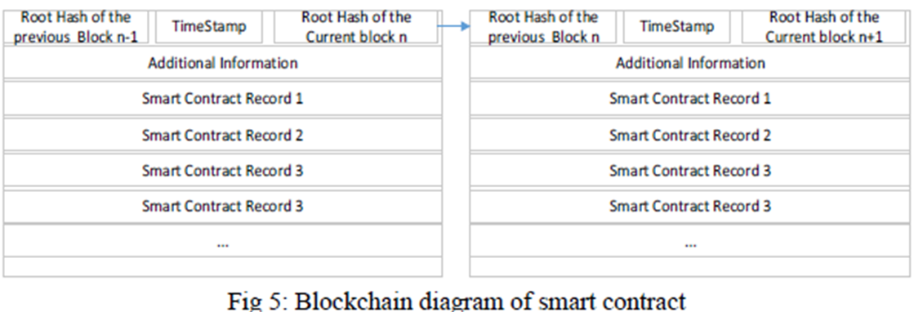

Slide 61
The execution of smart contracts is based on the "event-triggered" mechanism.
The smart contract on the blockchain contains transaction processing and saving mechanisms and a complete state machine for accepting and processing various smart contracts.
The smart contract periodically traverses the state machine and trigger conditions of each contract, pushing the contract that meets the trigger condition to the queue to be verified.
The contract to be verified will spread to each node, just like a normal transaction.
The node will first verify the signature to ensure the legitimacy of the contract.
The validated contract will be successfully executed after reaching a consensus.
Finally, all nodes will reach a consensus on the contract.

Slide 62
The processing of the entire contract is automatically completed by the smart contract system built into the bottom of the blockchain, which is open and transparent and cannot be tampered with.
Smart contract system can actively or passively accept, store, process and send data, and call smart contract, so as to control and manage digital objects in the chain.
The smart contract technology platforms that have emerged, such as Ethereum and Hyperledger, have Turing's complete development scripting language, enabling the blockchain to support smarter contract applications for financial and social systems

Slide 64
Problems to be solved in blockchain data analysis
Based on relevant literature analysis, the focus of blockchain data analysis can be summarized into seven aspects:
entity identification,
privacy risk analysis
network portrait,
network visualization,
transaction pattern recognition,
market effect analysis,
illegal behaviour detection and analysis

Slide 65
Figure shows the relationship between these seven questions.
Solid arrows indicate that the previous study supports the next one, or that the previous study is the basis for the next one.
The dotted arrow indicates that the latter study is a specialization of the previous study from a certain perspective.
Two-way arrows indicate different aspects of the same problem.

Slide 66
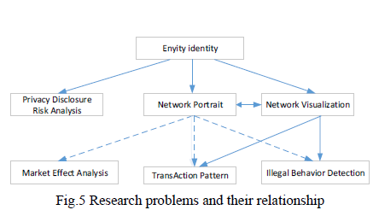

Slide 67
(1) Entity identification
In Bit coin transactions, users are anonymous.
transaction involves multiple users, and one user may participate in multiple transactions at the same time.
A natural question is: can you identify users from transaction records, or which addresses belong to the same user?
Since it is not possible to confirm that a user is identified, it is generally considered in the literature that an entity is identified.
An entity may be a user or an organization, and a user or an organization may also control multiple entities at the same time.

Slide 68
Heuristic methods are often used to identify potential entities, which can be divided into two main types:
common input method --that all input addresses belong to the same entity in a transaction.
change address method. ---the change address represents an entity.
The change address definition is a plurality of output addresses of a transaction,

Slide 69
(2) Privacy protection.
Blockchain privacy protection can be divided into
identity privacy protection
transaction privacy protection.
Identity privacy protection requires that user's identity information, physical address, IP address are not related to user's public key, address and other public information on the blockchain.
Any unauthorized node can neither obtain any information about the user's identity by relying on the data disclosed in the blockchain, nor can it track and analyse user transactions and identity information through measures such as network monitoring and traffic analysis.

Slide 70
Transaction privacy protection requires that the data information of the transaction itself be anonymous to the unauthorized node.
The transaction information in Bitcoin refers to the transaction amount, the sender's public key of the transaction, the address of the recipient, and the purchase content of the transaction.
Any unauthorized node cannot obtain transaction-related knowledge through effective technical means.
In some blockchain that require high privacy protection, it is also required to separate the relationship between transactions and transactions, that is, the unauthorized nodes cannot effectively infer whether the two transactions have continuity, whether they belong to the same user or the like.

Slide 71
(3) Network portrait
In the face of massive transaction data, researchers hope to analyse
How many users are involved in the transaction?
What are the characteristics of these users?
Does this huge payment network have the characteristics of a general complex network?
Bitcoin as an "asset", how is it distributed among users?
Do you meet the general laws of economics, etc.?
And from the point of view of complex network, the characteristics of Bitcoin network are analysed.

Slide 72
(4) Network visualization
With the prevalence of blockchain technology, the transaction data stored in the blockchain increases rapidly.
Therefore, in the face of a large and rapidly growing trading network, it is an important research direction to study its visualization tools.
For example,
the bitcoin trading network's visualization system, BitConeView, can be used to track bitcoin transactions in real time and intuitively.
Especially, the system defines the concept of "purity" so as to find out the mixed currency transactions conveniently and monitor the potential money laundering banks in the Bitcoin network in real time.

Slide 73
5. Market Effect Analysis
The prices of encrypted currencies such as Bitcoin are highly volatile.
From the perspective of finance. this extremely high volatility has attracted economists to discuss whether bitcoin is a currency or not
On the other hand, from the perspective of data analysis, researchers hope to explain the driving factors behind this extreme volatility.
It is generally believed that the influencing factors include:
miner behaviour;
cryptographic currency system settings;
user participation;
policy;
number of potential users and market sentiment;
competition or alternative relationship with other cryptocurrencies and traditional assets.

Slide 74
(6) Illegal behaviour detection.
Unlike traditional bank payment systems, Bitcoin is an anonymous, non-centralized payment system.
Anonymous features lead to many illegal activities in bitcoin transactions, such as money laundering, fraudulent gambling, and the sale of contraband.
These illegal acts of exposure are only a small part, and a large number of illegal acts are not known.
Measures to Identify illegal behaviours based on transaction patterns and blockchain data analysis techniques helps to promote the healthy development of blockchain technology and can also provide reference for the supervision and legislation of the blockchain industry

Slide 75
(7) Transaction pattern recognition
Unlike traditional payment systems such as Banks, bitcoin is an anonymous, decentralized payment system.
An important question is the human payment behaviour in the context of anonymity
It is a valuable question whether specific patterns can be identified from blockchain transaction records to detect related illicit activity.

Slide 76
Types of blockchain network
#. Public + Permissionless Blockchains. Ex: Bitcoin, Ethereum, Litecoin
#. Private + Permissioned Blockchains. Ex: Multichain, Monax #. Consortium Blockchains . Ex: R3, EWF, Corda

Slide 77
Use case
#. Voting & Governance
#. Supply Chain management.
#. Subsidy distribution/ Crowdfunding.
#. Real time money transfer.
#. Audit Logs
#. Sharing Economy.

Slide 78
Important questions
What is meant by Block Chaining?
With neat diagram explain blockchain data structure
What are the types of blockchain based on the classification according to different application scenarios and network admission mechanism
Hint- Public, Private and Alliance
What is Contract Data ?
Hint- definition of smart contract. Elaborate according to marks
Explain the Data models in Blockchain
Hint- transaction data model and account based data model. Explain with diagram
Explain with block diagram the Smart contract structure
Explain the Blockchain architecture in detail.
Hint- 3 layer- application,contract, transaction
Explain the problems to be solved in Blockchain Data Analysis.

Slide 79
https://www.youtube.com/watch?v=_160oMzblY8 https://www.youtube.com/watch?v=93E_GzvpMA0 https://anders.com/blockchain
https://www.slideshare.net/feronera/blockchain-introduction-80908060
https://blockgeeks.com/guides/what-is-hashing/ https://www.quandl.com/data/BCHAIN/NTRBL-Bitcoin-Number-of-Transaction-per-Block
https://blockgeeks.com/guides/what-is-blockchain-technology/
https://www.codemag.com/Article/1805061/Understanding-Blockchain-A-Beginners-Guide-to-Ethereum-Smart-Contract-Programming
https://www.movable-type.co.uk/scripts/sha256.html[FOR SHA256 ]

Slide 80
https://www.primafelicitas.com/blockchain-data-structure /

Slide 81
https://academy.horizen.io/technology/expert/blockchain-as-a-data-structure/

Slide 82
https://www.edureka.co/blog/blockchain-tutorial/
https://www.youtube.com/watch?v=WeuJqKEfSxM
https://medium.com/@sukantkhurana/a-very-basic-introduction-to-blockchain-in-cryptocurrencies-974be2914d96
https://blockgeeks.com/guides/what-is-blockchain-technology

